Slide 1
PROJECT REVEND 1.0
BY team Keep Thinking Innovatively

Slide 2
Problem Statement : A Cost-Effective Reversible Vending Machine for Plastic Waste Management"
Universities generate a large amount of plastic waste every day.
There is a lack of proper waste management systems to effectively handle and recycle this plastic.

Slide 3
Solution Statement:
Create a low-cost Reversible Vending machine to collect and identify plastic waste for recycling.
Dispense cash rewards to promote eco-friendly waste disposal

Slide 4
We mainly depend on
Reliable sensors
Rewards System to Motivate users
Suitable public spaces where the machines can be installed
Regulatory Approval
Collaboration with local businesses
Maintenance Infrastructure

Slide 5
BUDGET PLANNING
Component | Material | Cost (INR)
Main Body | Cast Iron | 27,000
Hydraulic system | - | 11000
Heating Coil | Nichrome Wire | 4000
Cooling Exhaust Fans (x2) | Plastic/Metal | 2,000
Processor | Raspberry Pi Pico | 1200
Pi Camera | 8 MP Resolution | 2,000
Ultrasonic Sensor | HC-SR04 | 300
DC Motors (x3) | 12V, 5A | 4000
Metal Bin Container | Cast Iron (50 kg) | 4,000
Temperature sensor | - | 3000
Touch screen display 12*7’’ | - | 7000
Additional circuit costs | - | 10,000
Servers and software | - | 10,000
TOTAL |  | 85,500

Slide 6
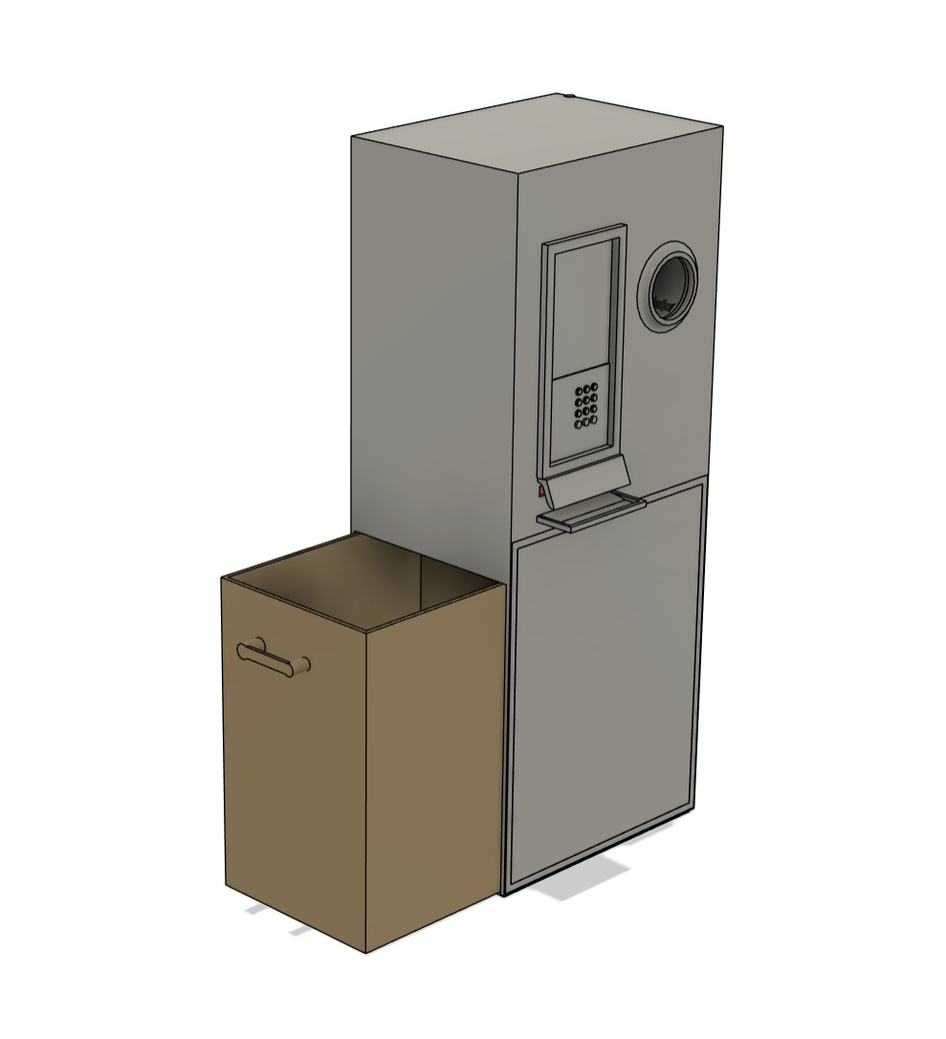
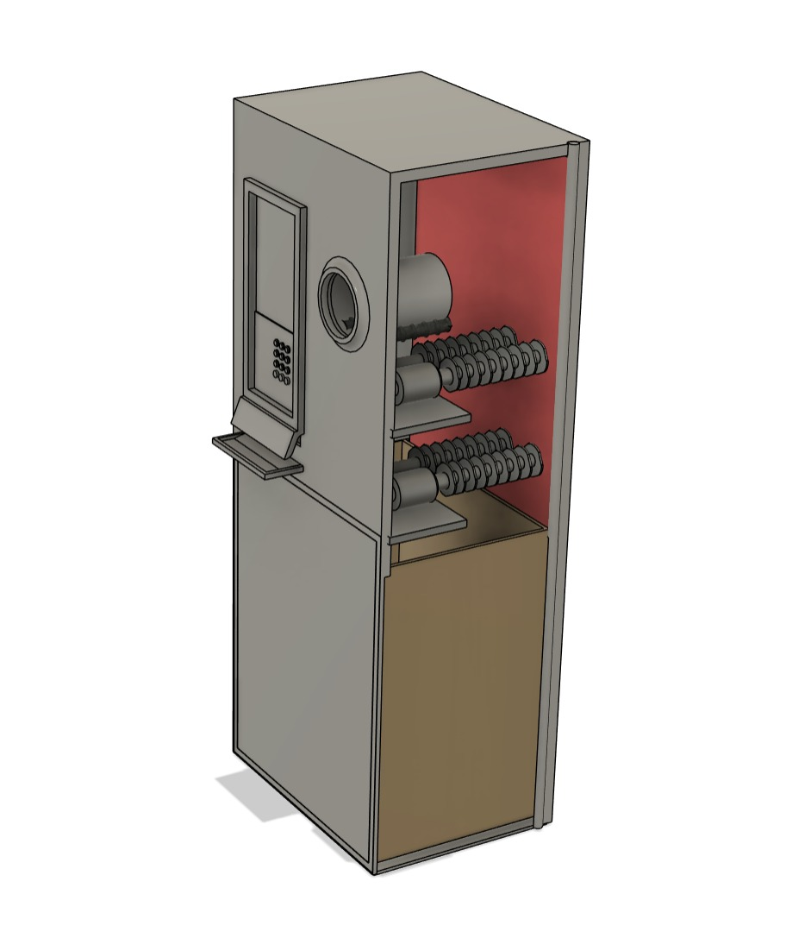
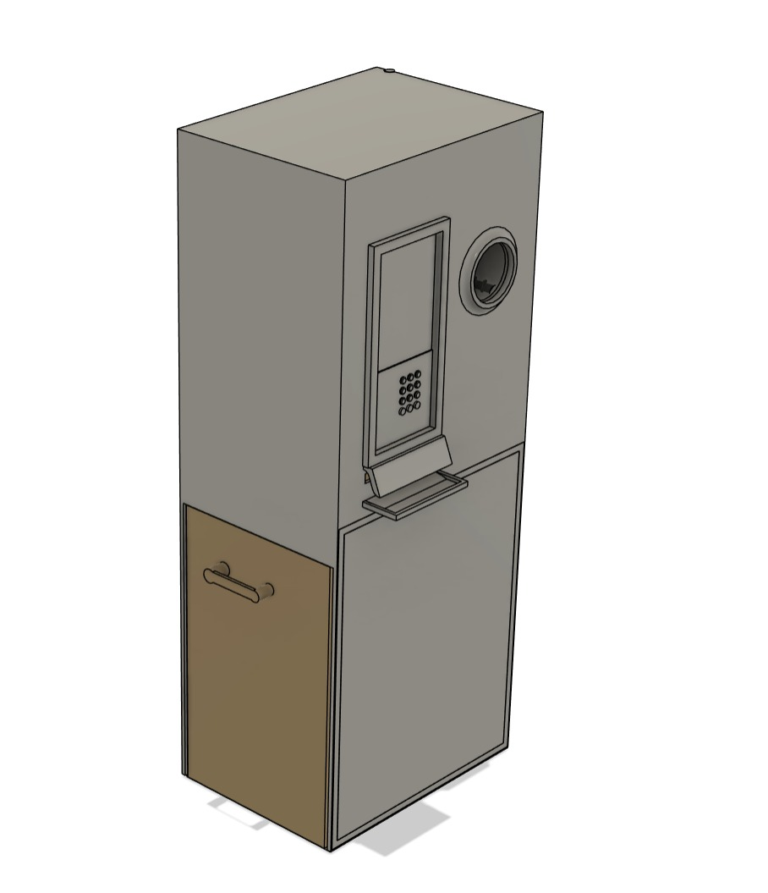
Prototype
4

